Slide 1


Protein Identification
Mass Spectrometry

Slide 2
#description of the data
Peptides were identified during degradation of the diatom Thalassiosira weissflogii with and with the use of the enzyme trypsin. This allows comparison of protein degradation occurring within the experiment (no trypsin added; peptides already present due to in situ degradation) and the protein still available for future degradation (peptides released from protein when trypsin is added during analysis)

Slide 3

#Code

Slide 4
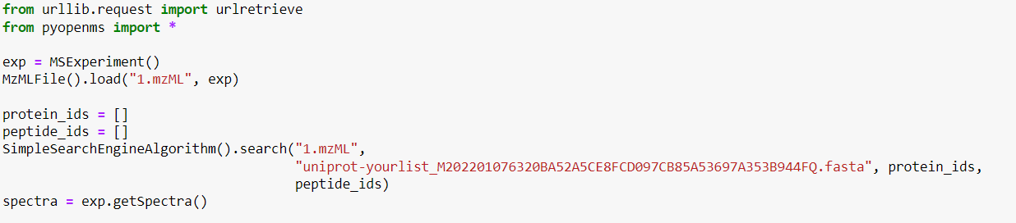
1.Simple Search

Slide 5
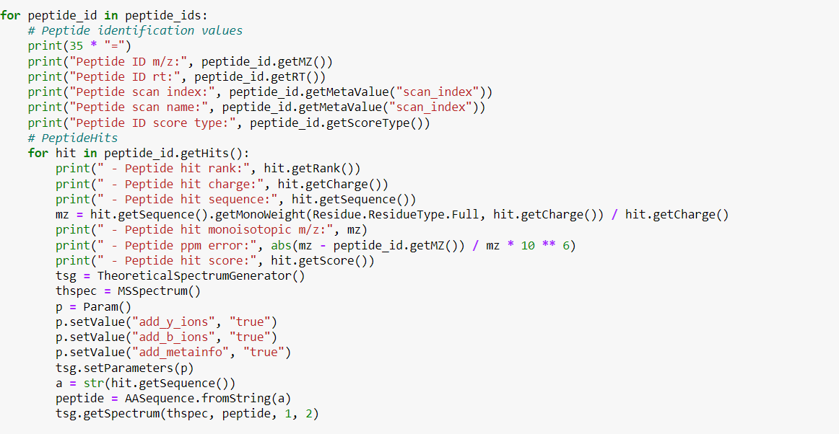
2.Matched Peptides

Slide 6
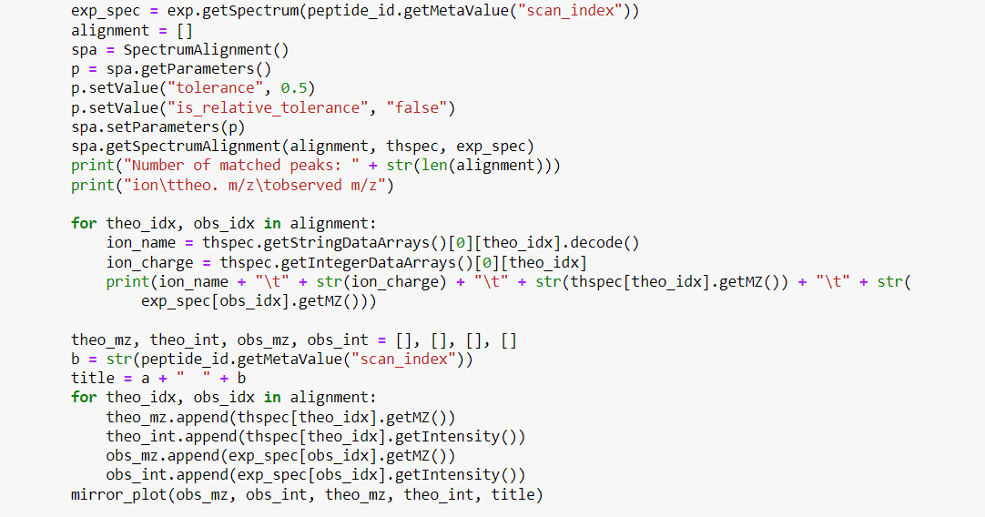
3.Alignment

Slide 7
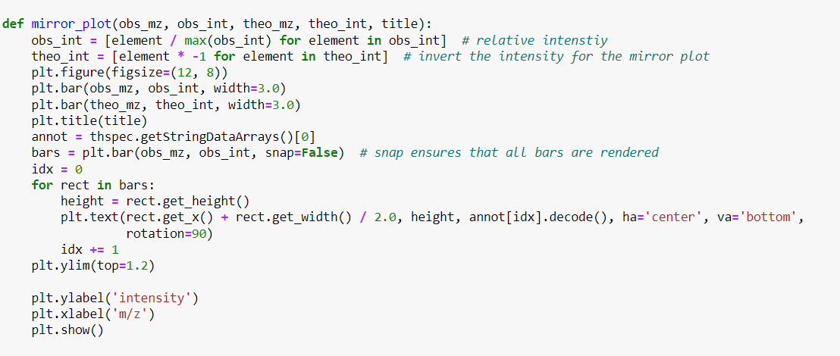
4.Graphs

Slide 8
#Alignment Results
Alignment 1

Slide 9
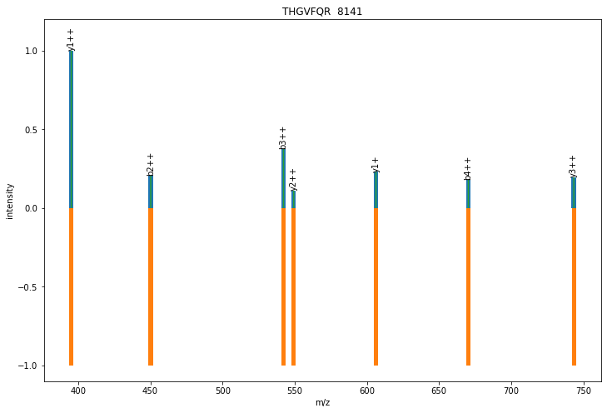
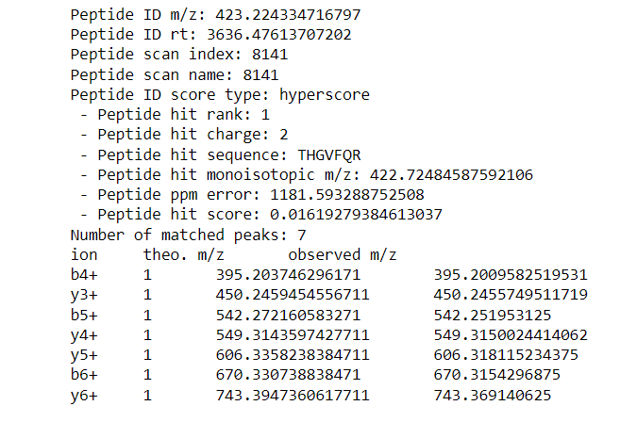
Matched 1

Slide 10
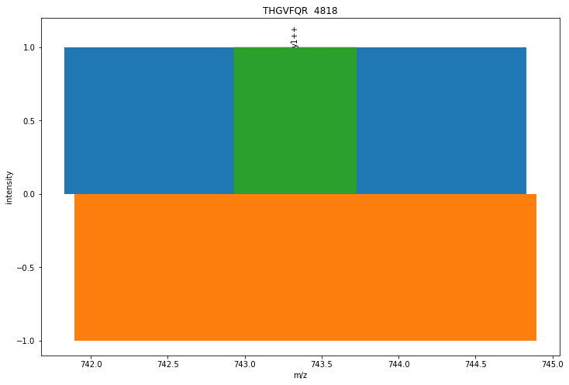
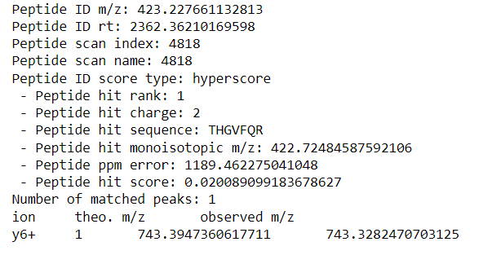
Matched 2

Slide 11
#Alignment Results
Alignment 2

Slide 12
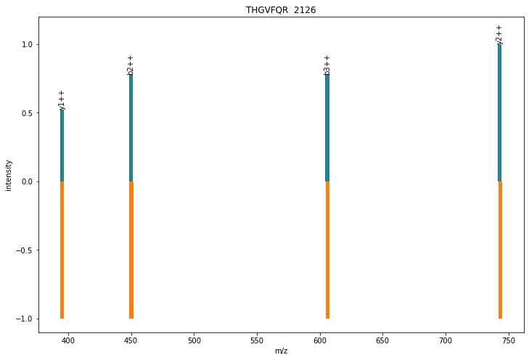
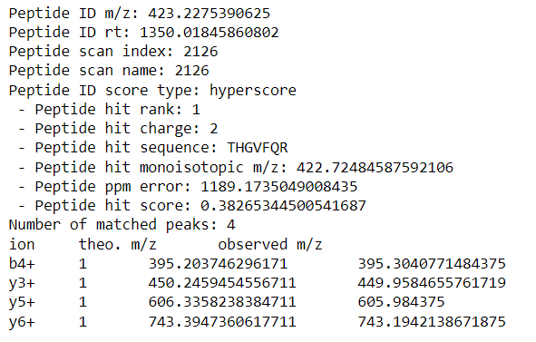
Matched 1

Slide 13
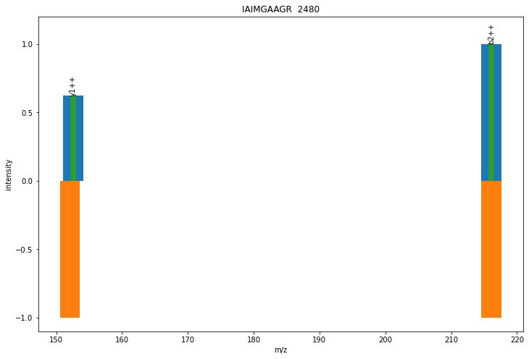
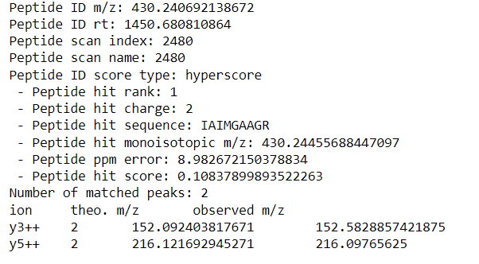
Matched 2

Slide 14
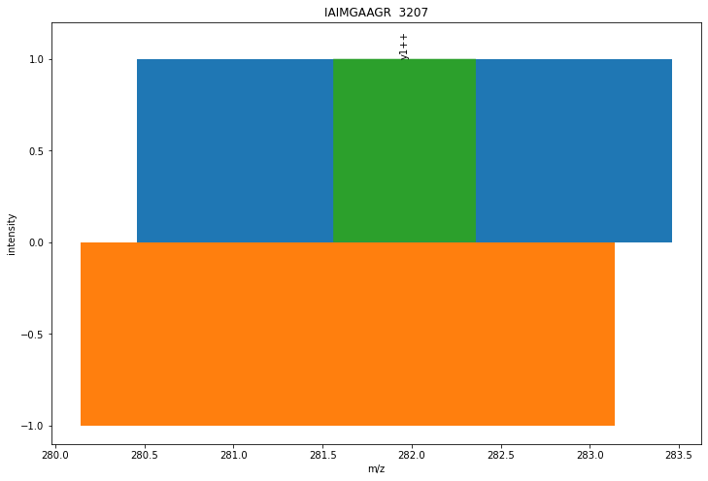
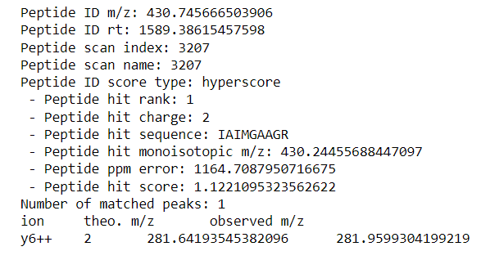
Matched 3

Slide 15
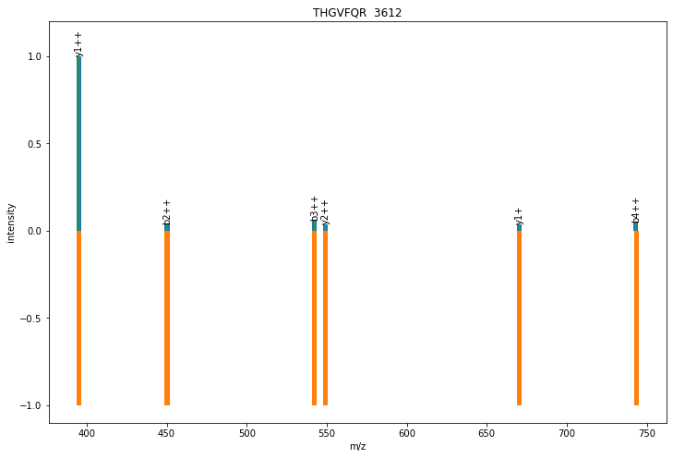
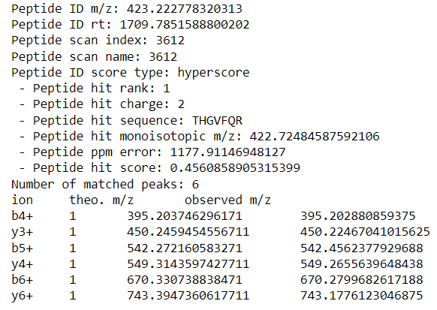
Matched 4

Slide 16
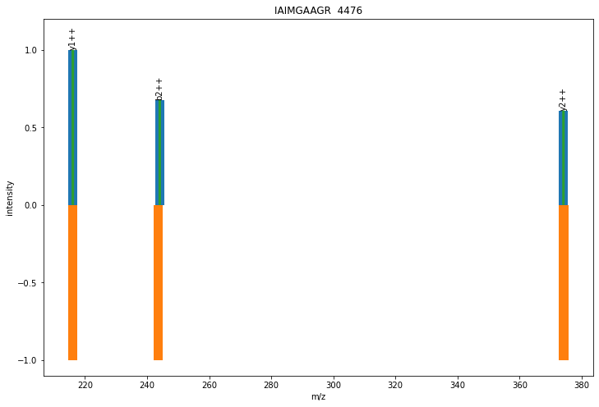
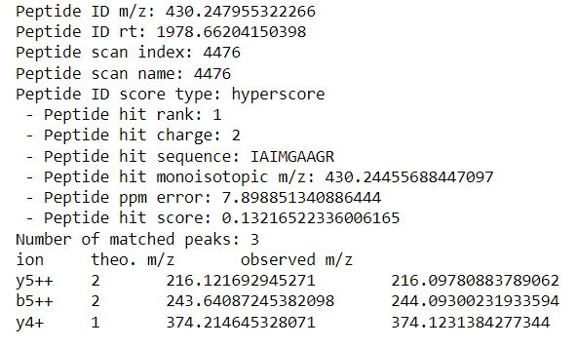
Matched 5

Slide 17
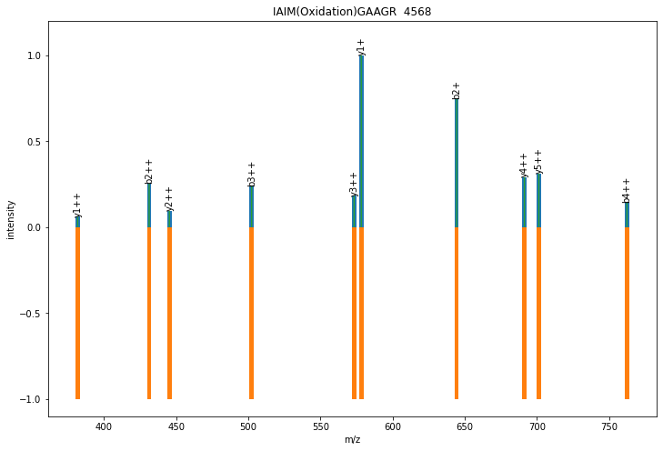
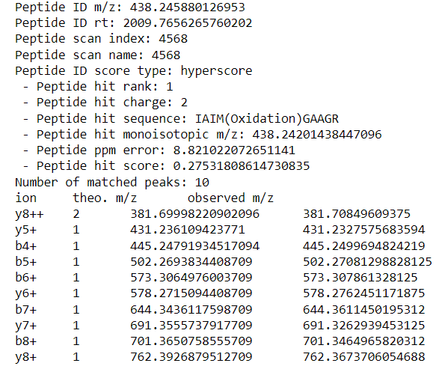
Matched 6

Slide 18
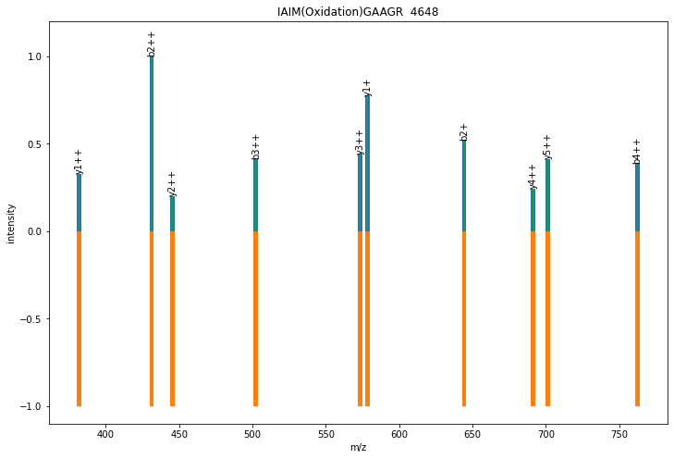
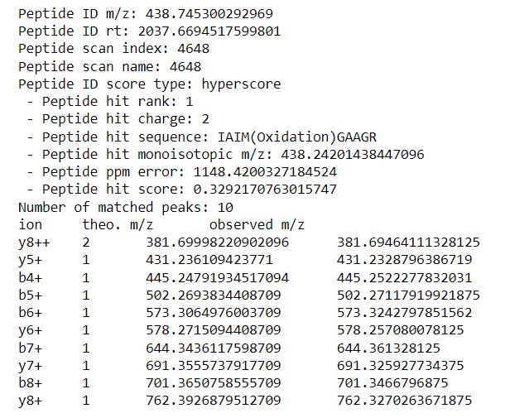
Matched 7

Slide 19
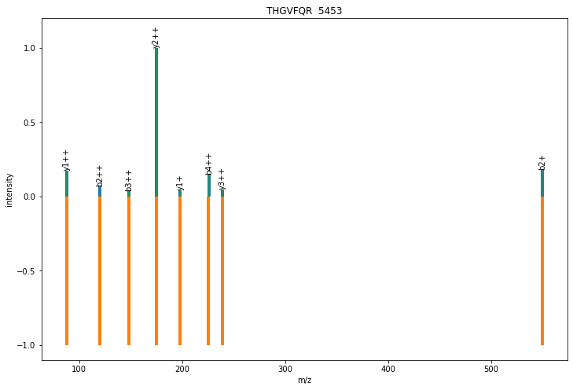
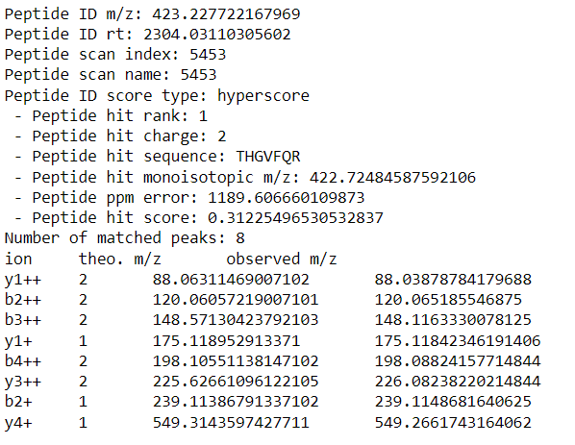
Matched 8

Slide 20
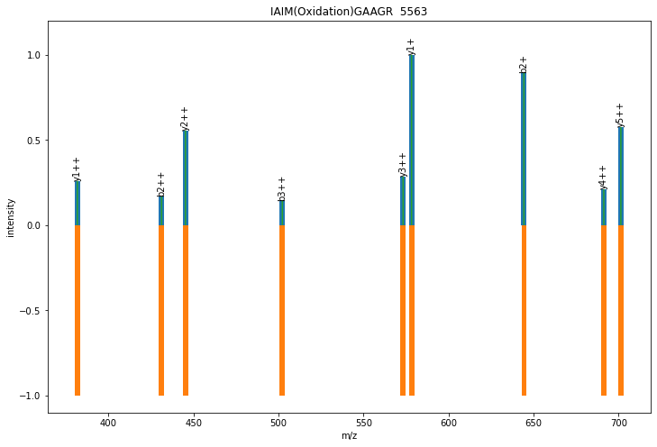
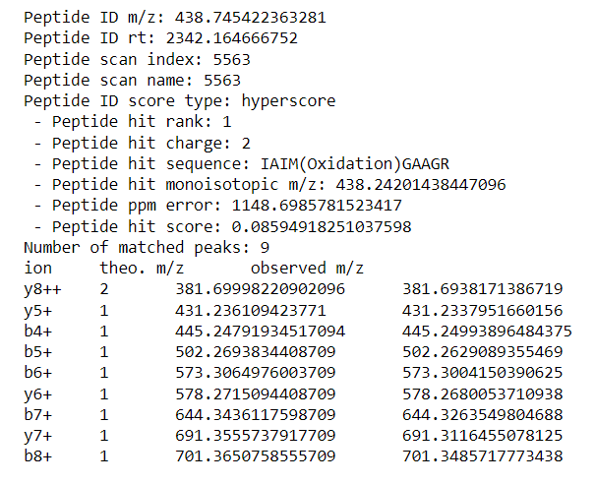
Matched 9

Slide 21
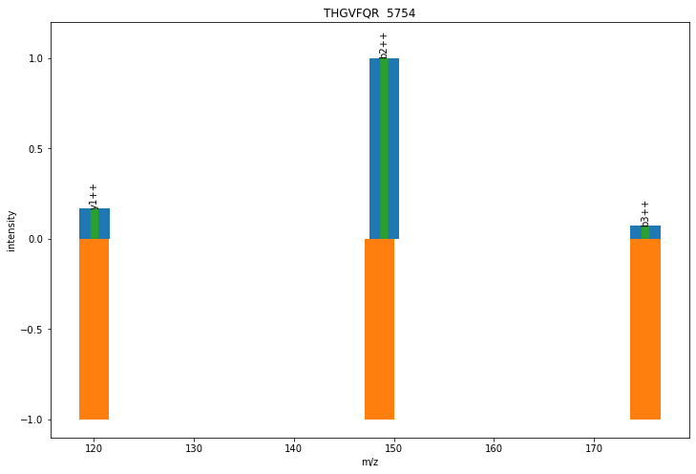
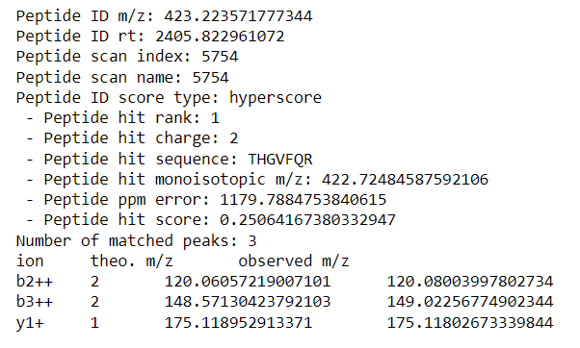
Matched 10

Slide 22
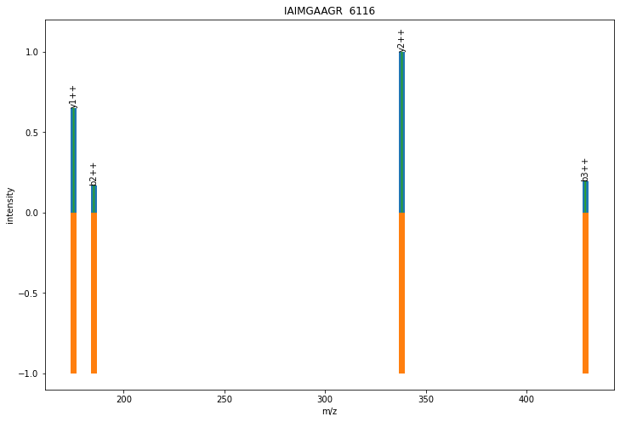
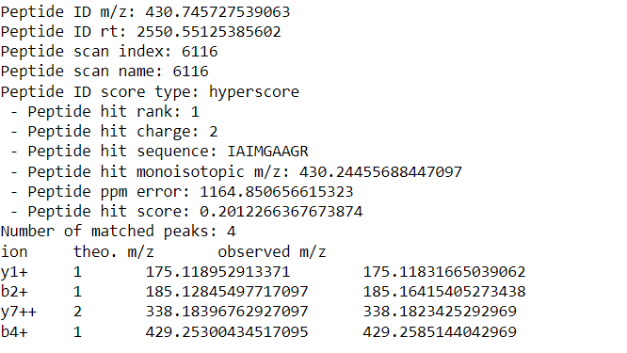
Matched 11

Slide 23
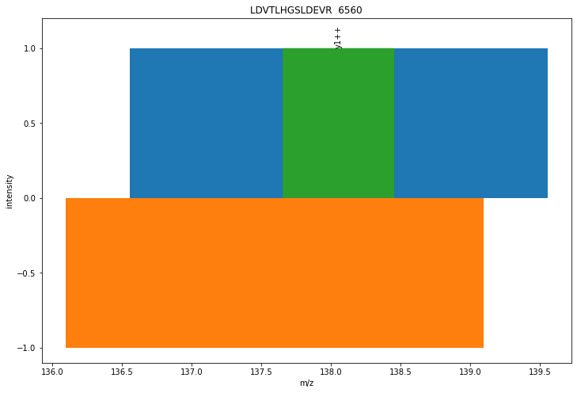
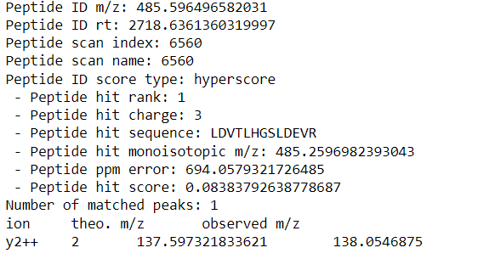
Matched 12

Slide 24
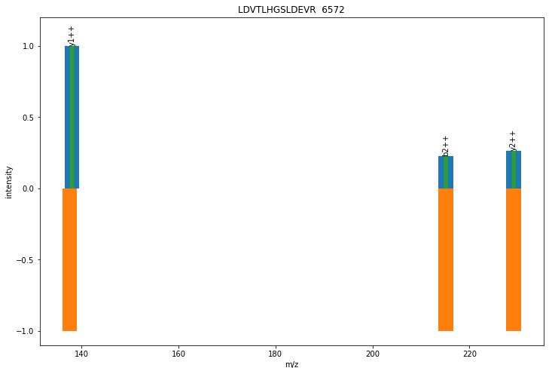
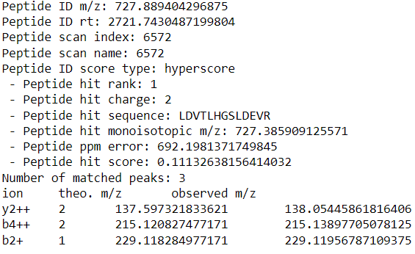
Matched 13

Slide 25
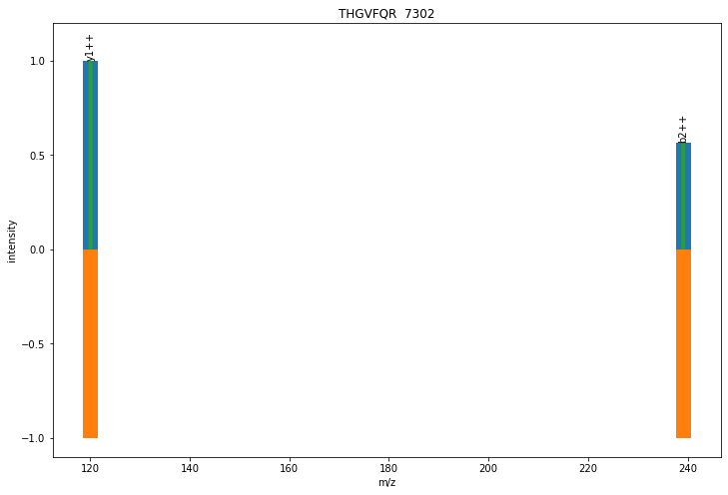
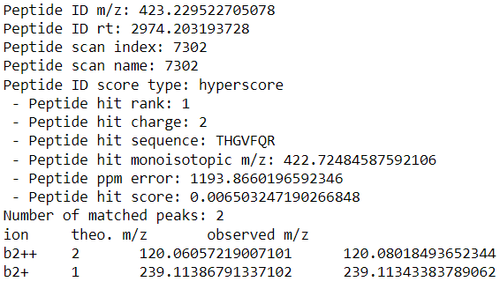
Matched 14

Slide 26
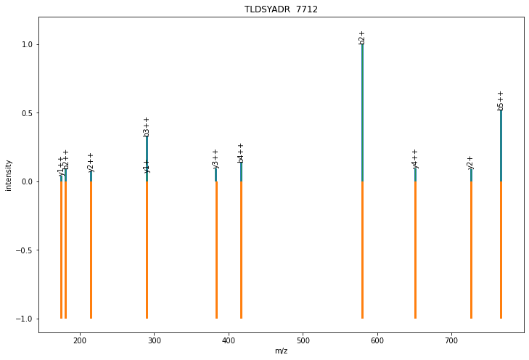
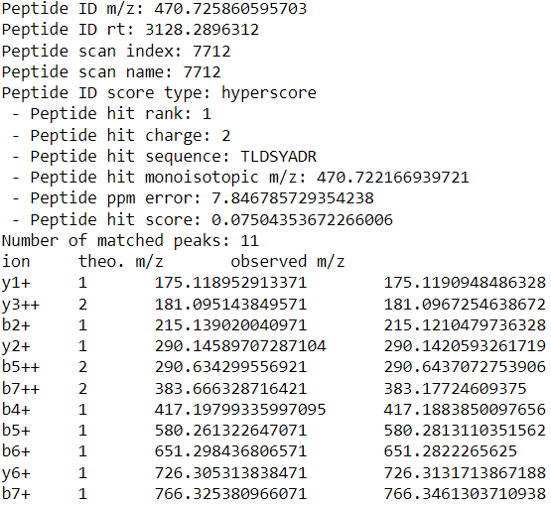
Matched 15

Slide 27
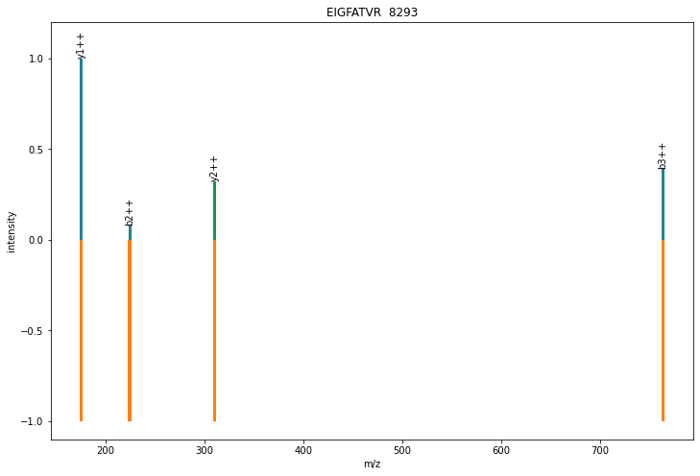
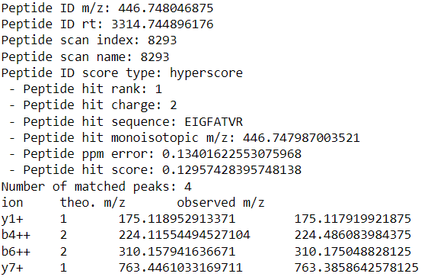
Matched 16

Slide 28
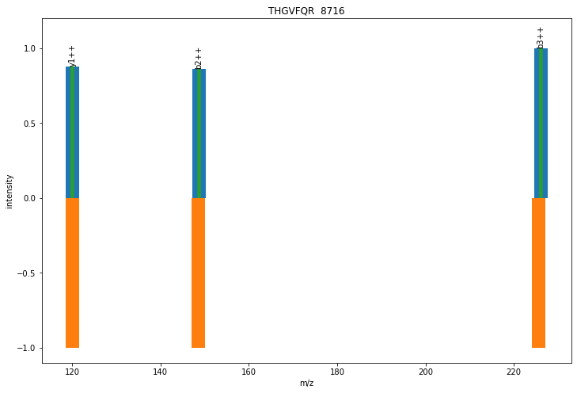
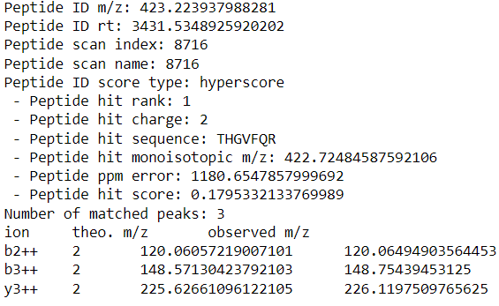
Matched 17

Slide 29
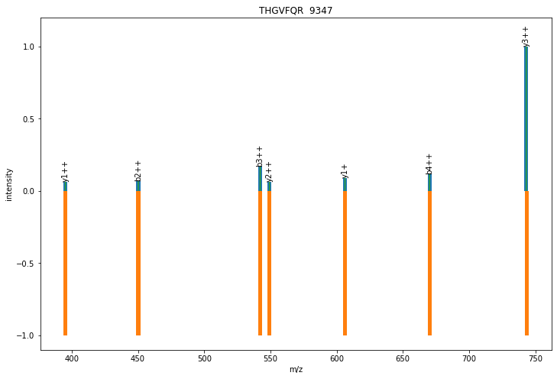
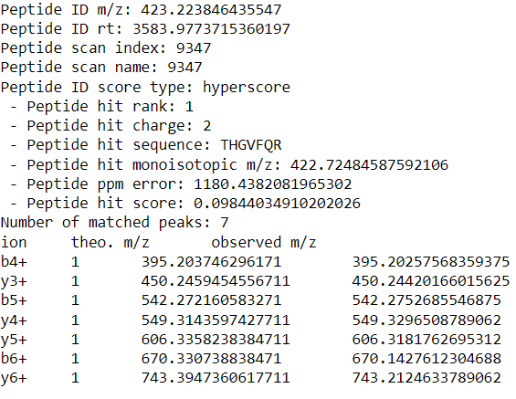
Matched 18

Slide 30
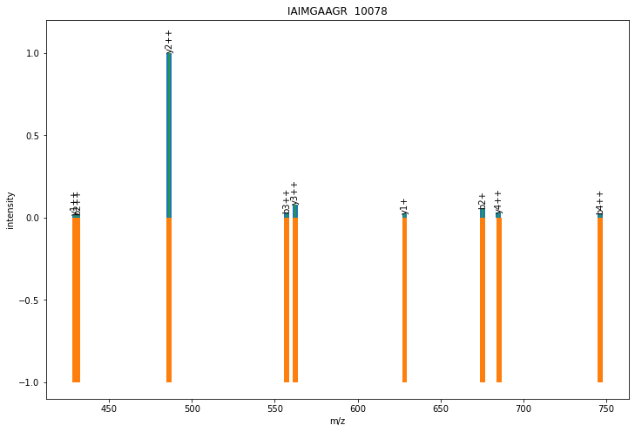
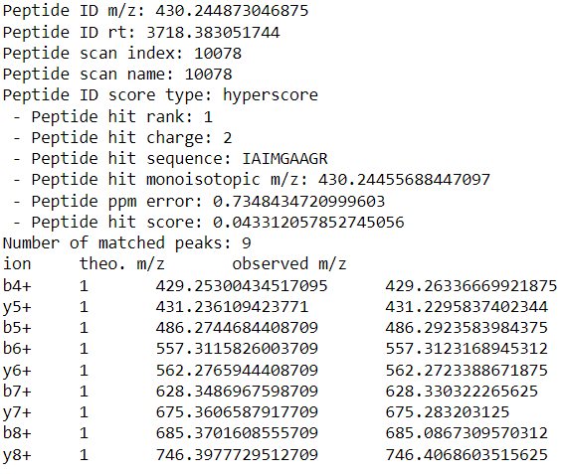
Matched 19

Slide 31
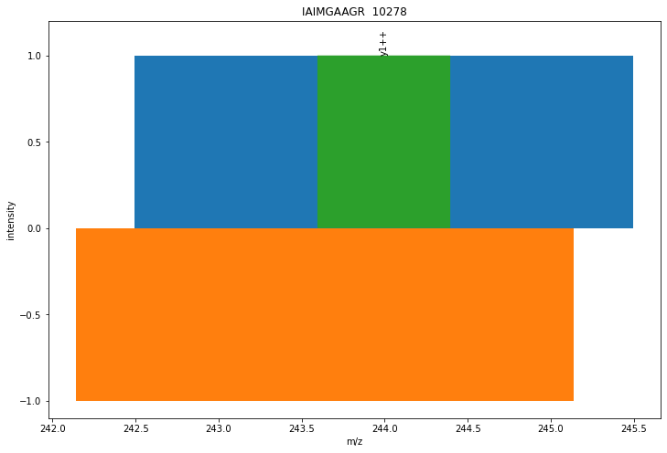
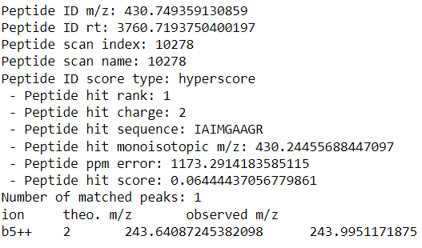
Matched 20

Slide 32
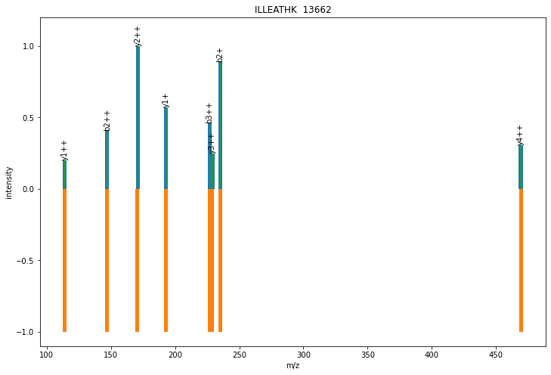
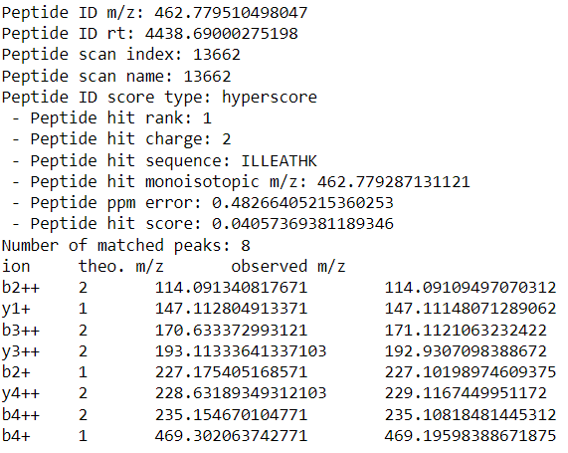
Matched 21

Slide 33
#Alignment Results
Alignment 3

Slide 34


Matched 1

Slide 35


Matched 2

Slide 36


Matched 3

Slide 37


Matched 4

Slide 38


Matched 5

Slide 39


Matched 6

Slide 40


Matched 7

Slide 41


Matched 8

Slide 42


Matched 9

Slide 43


Matched 10

Slide 44


Matched 11

Slide 45


Matched 12

Slide 46


Matched 13

Slide 47


Matched 14

Slide 48


Matched 15

Slide 49


Matched 16

Slide 50


Matched 17

Slide 51


Matched 18

Slide 52


Matched 19

Slide 53


Matched 20

Slide 54


Matched 21

Slide 55


Matched 22

Slide 56


Matched 23

Slide 57


Matched 24

Slide 58


Matched 25

Slide 59
#Alignment Results
Alignment 4

Slide 60


Matched 1

Slide 61
#Alignment Results
Alignment 5

Slide 62


Matched 1

Slide 63
#Alignment Results
Alignment 6

Slide 64


Matched 1

Slide 65


Matched 2

Slide 66
#Alignment Results
Alignment 7

Slide 67


Matched 1

Slide 68


Matched 2

Slide 69
#Alignment Results
Alignment 8

Slide 70


Matched 1

Slide 71


Matched 2

Slide 72
#Alignment Results
Alignment 9

Slide 73


Matched 1

Slide 74


Matched 2

Slide 75


Matched 3

Slide 76


Matched 4

Slide 77


Matched 5

Slide 78


Matched 6

Slide 79


Matched 7

Slide 80
#Alignment Results
Alignment 10

Slide 81


Matched 1

Slide 82


Matched 2

Slide 83


Matched 3

Slide 84


Matched 4

Slide 85


Matched 5

Slide 86


Matched 6

Slide 87


Matched 7

Slide 88


Matched 8

Slide 89


Matched 9

Slide 90


Matched 10

Slide 91


Matched 11

Slide 92
#Alignment Results
Alignment 11

Slide 93


Matched 1

Slide 94


Matched 2

Slide 95


Matched 3

Slide 96


Matched 4

Slide 97


Matched 5

Slide 98


Matched 6

Slide 99
#Alignment Results
Alignment 12

Slide 100


Matched 1

Slide 101


Matched 2

Slide 102


Matched 3

Slide 103


Matched 4

Slide 104

Thank You

